Slide 1
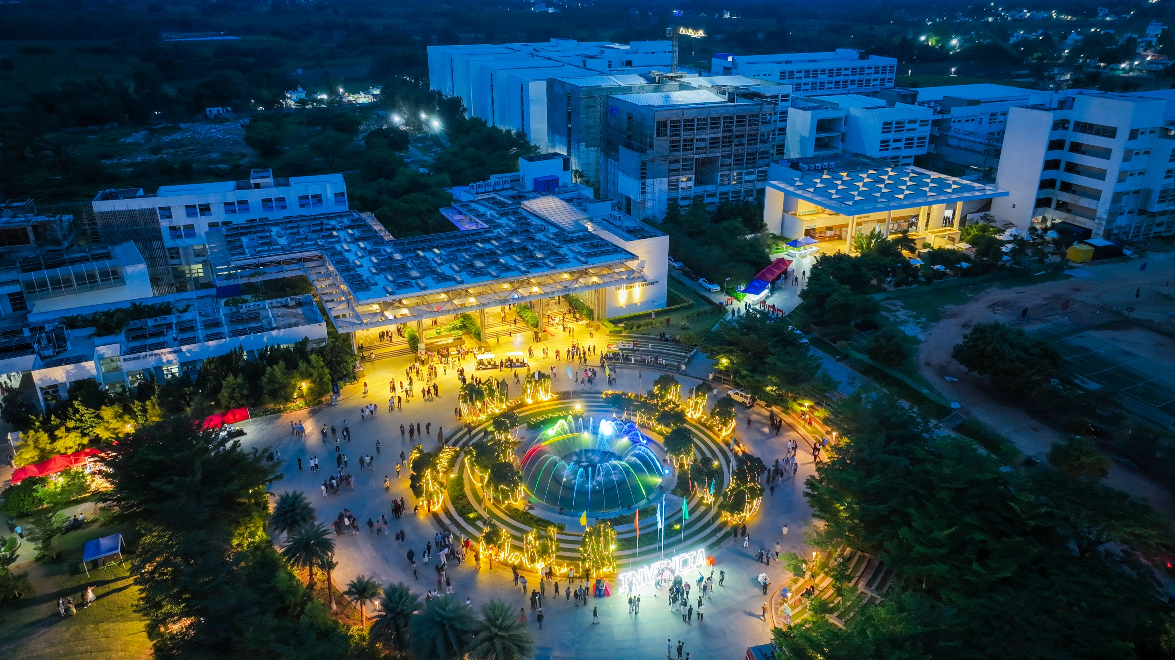

1
Presidency
Presidency
School of Engineering

Slide 2
Department of
Electronics and Communication Engineering

Slide 3
Basics of Electronics and Communication Engineering (ECE3107)
L-T-P-C: 3-0-0-3
By
Dr. K. Gowri
Assistant Professor – Senior Scale
Department of Electronics and Communication Engineering
Presidency University, Bengaluru

Slide 4
MODULE 3
ROBOT Vision:
Basic introduction to Robotic operating System (ROS) - Real and Simulated Robots - Introduction to OpenCV, Open NI and PCL, installing and testing ROS camera Drivers, ROS to OpenCV - The cv_bridge Package

Slide 5
MODULE 3
ROBOT Vision:
Basic introduction to Robotic operating System (ROS) - Real and Simulated Robots - Introduction to OpenCV, Open NI and PCL, installing and testing ROS camera Drivers, ROS to OpenCV - The cv_bridge Package

Slide 6
kinematics
How to move?
Navigation
How to think?
How to move?
AI/ML
Controls
How to move precisely?
Robotics
SLAM- Simultaneous localization and moving
How to create map while moving
Motion planning
How to choose a right path?
Computer vision
How to see

Slide 7
MODULE 3
To communicate with robot, we need code
PYTHON
Why?
Free, open source
Strong community support
Easy syntax
Many existing packages

Slide 8
Steps
Camera calibration
Find object location and orientation
Determine robot path
Move each robot joint
Open and close the gripper

Slide 9
Steps in camera calibration
Images
Camera calibration
Camera location

Slide 10
ROS - Robot Operating System
The Robot Operating System (ROS) is a set of software libraries and tools that help you build robot applications.
Open source software.

Slide 11
REAL AND SIMULATED ROBOTS
While ROS can be used with a large variety of hardware, you don't need an actual robot to get started.
ROS includes packages to run a number of robots in simulation so that we can test our programs before venturing into the real world.
Gazebo, Stage, and the ArbotiX Simulator:
There are a number of ways to simulate a robot in ROS.
1. Gazebo, a full-featured 3-D physics simulator that pre-dates ROS but now integrates nicely with it.
2. Stage, a simpler 2-D simulator that can manage multiple robots and various sensors such as laser scanners.
3. Michael Ferguson's arbotix_python package that can run a fake simulation of a differential drive robot but without sensor feedback or any physics.

Slide 12
Gazebo, Stage, and the ArbotiX Simulator
The last method as it is the simplest to set up and we don't need physics for our purposes.
Gazebo and Stage but be prepared to spend a little time working on the details.
Gazebo in particular demands a fair bit of CPU power.

Slide 13
TurtleBot, Maxwell and Pi Robot
we need a robot that we can at least run in simulation to test our code.
The ros-by-example repository includes support for two test robots,
The Willow Garage TurtleBot created by Melonee Wise and Tully Foote
The author's own home-built robot called Pi Robot.

Slide 14
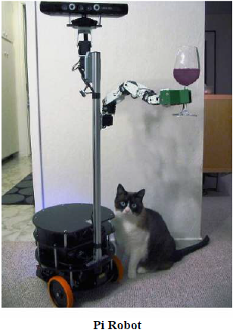
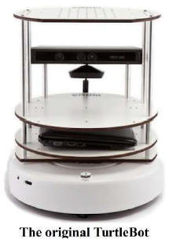

Slide 15
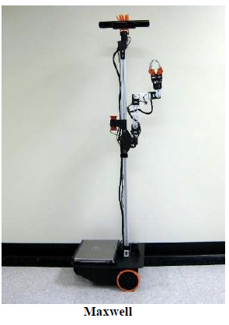
t
Pi was inspired by Michael Ferguson's Maxwell which in turn was modeled after Georgia Tech's EL-E robot.
In any event, most of the code we develop will run on almost any robot that supports the basic ROS message interfaces.

Slide 16
t
a

Slide 17
t
a

Slide 18
t
a

